Slide 1

数据挖掘导论 Introduction to Data Mining 第三章：分类问题b
王浩
Email：haowang@szu.edu.cn
电子信息与工程学院

Slide 2
目标：
认识神经元模型
认识人工神经网络
常见代价函数
梯度下降
反向传播
改进&优化

Slide 3
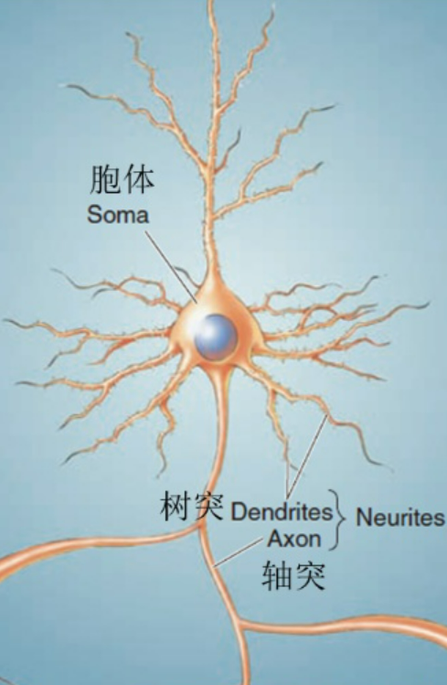
生物神经元：

Slide 4
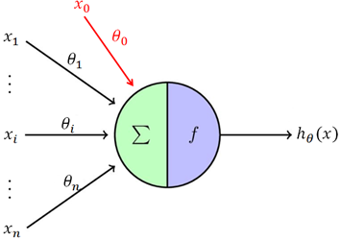
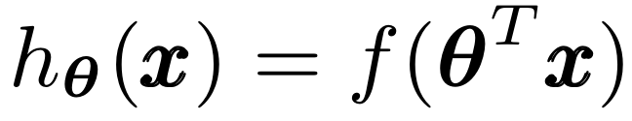
人工神经元：
激活函数：非线性化
Notes:
线性函数

Slide 5
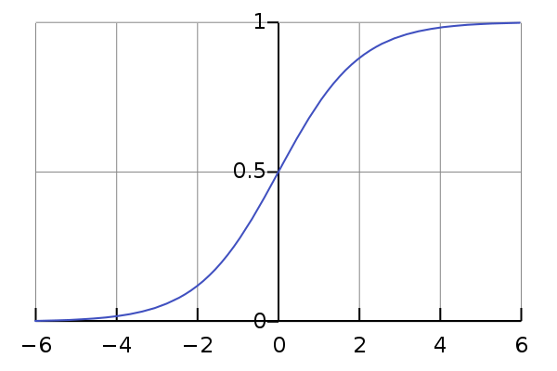
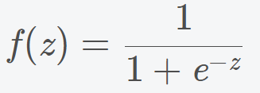

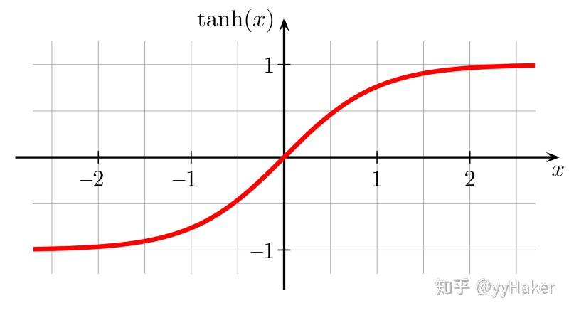

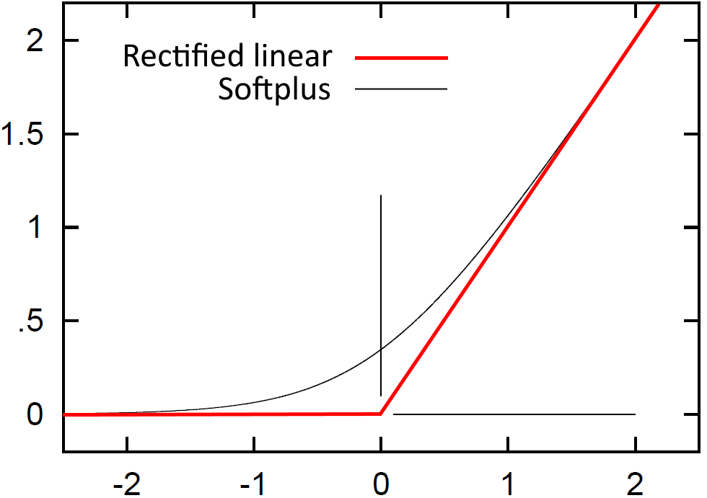

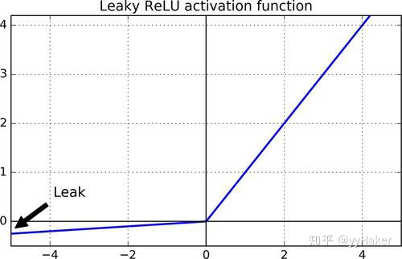

激活函数f()：
Sigmoid:
Tanh:
Relu:
Softplus：
Leaky-ReLU：
（P-ReLU）

Slide 6
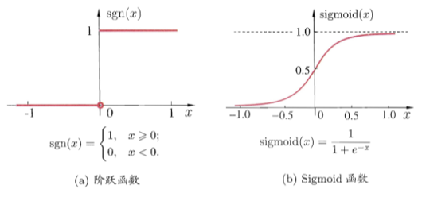





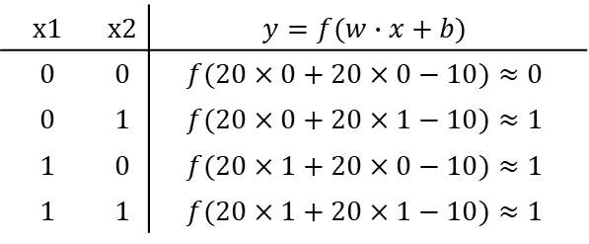
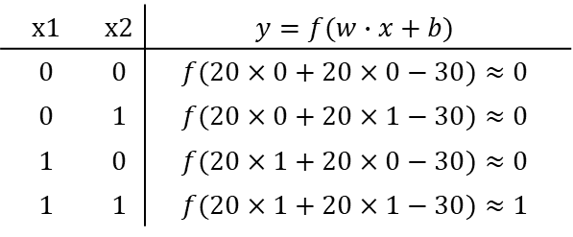





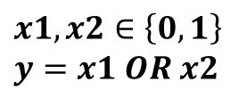

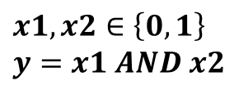

人工神经元举例：
$$x1,x2∈\left\{0, 1\right\}$$
$$y=x1 AND x2$$
$$x1,x2∈\left\{0, 1\right\}$$
$$y=x1 OR x2$$
$$x1$$
$$20$$
$$x1$$
$$20$$
$$−30$$
$$y$$
$$−10$$
$$y$$
$$20$$
$$20$$
$$x2$$
$$x2$$
x1 | x2 | $$y=f(w∙x+b)$$
0 | 0 | $$f(20×0+20×0−30)≈0$$
0 | 1 | $$f(20×0+20×1−30)≈0$$
1 | 0 | $$f(20×1+20×0−30)≈0$$
1 | 1 | $$f(20×1+20×1−30)≈1$$
x1 | x2 | $$y=f(w∙x+b)$$
0 | 0 | $$f(20×0+20×0−10)≈0$$
0 | 1 | $$f(20×0+20×1−10)≈1$$
1 | 0 | $$f(20×1+20×0−10)≈1$$
1 | 1 | $$f(20×1+20×1−10)≈1$$

Slide 7
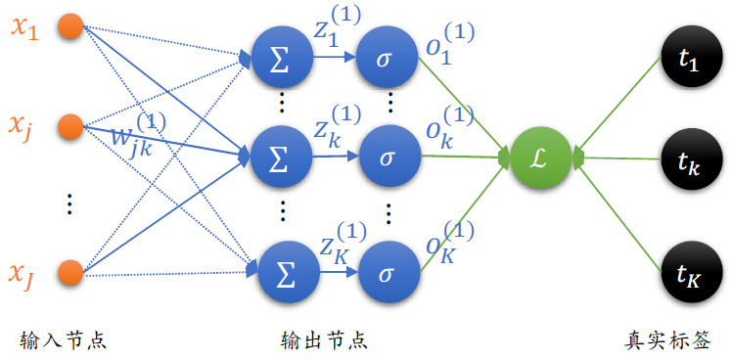

人工神经网络：
神经元
Notes:
写成矩阵形式

Slide 8
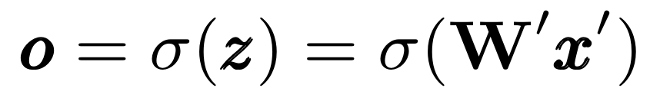

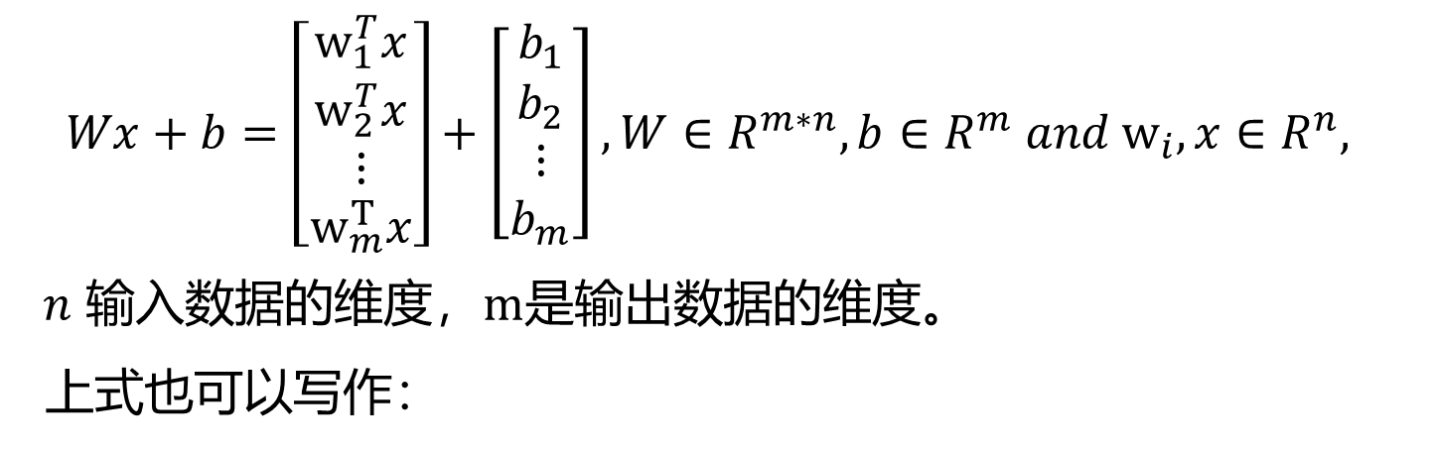
人工神经网络：
$$Wx+b=\left[\begin{matrix}w_{1}^{T}x \\ w_{2}^{T}x \\ ⋮ \\ w_{m}^{T}x\end{matrix}\right]+\left[\begin{matrix}b_{1} \\ b_{2} \\ ⋮ \\ b_{m}\end{matrix}\right],W∈R^{m∗n}, b∈R^{m} and w_{i},x∈R^{n},$$
$n$ 输入数据的维度，$m是$输出数据的维度。
上式也可以写作：
$$W′∈R^{m∗(n+1)}, x∈R^{n+1}$$

Slide 9
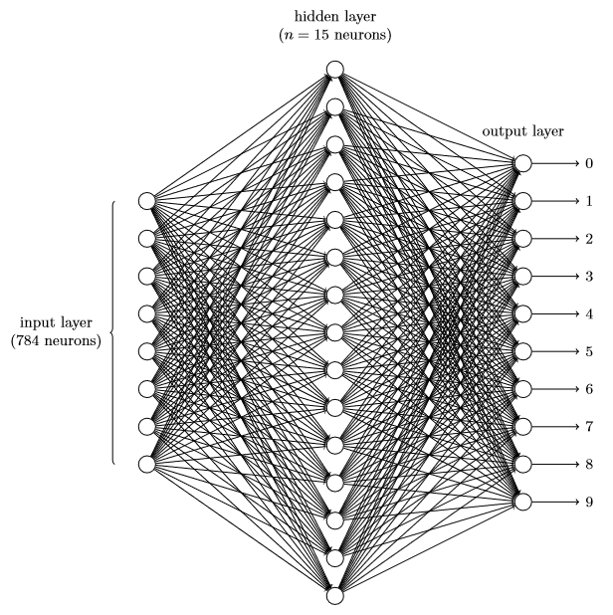
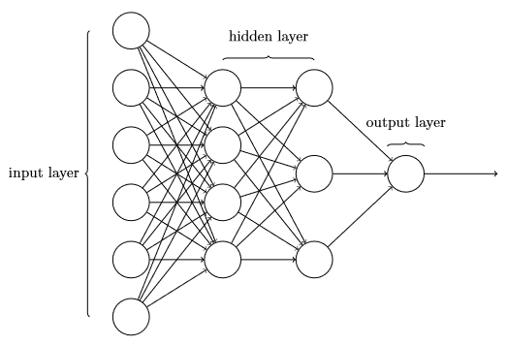
人工神经网络：
二分类
多分类

Slide 10
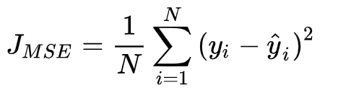
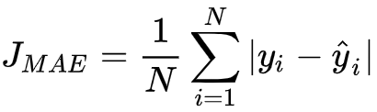
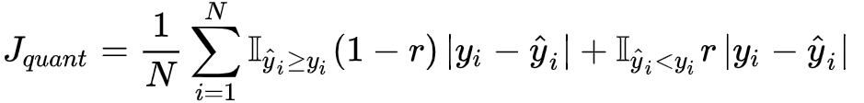
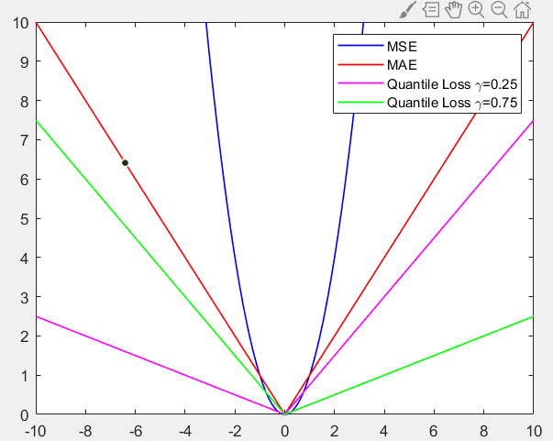
代价函数（Cost function/loss function）
均方差损失（Mean Squared Error Loss）
平均绝对误差损失（Mean Absolute Error Loss）
分位数损失（Quantile Loss）
MSE V.S. MAE ?
Or
L1-norm V.S. L2-norm
Notes:
W,b

Slide 11
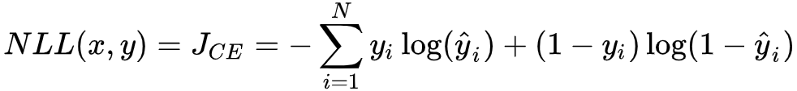
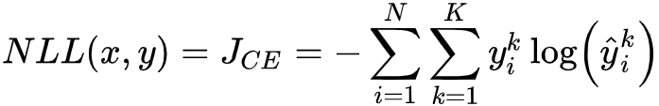
代价函数（Cost function/loss function）
交叉熵损失（Cross Entropy Loss）
二分类：
多分类：
二分类 V.S. 多分类 ？
函数的凹凸性？
Notes:
W,b

Slide 12
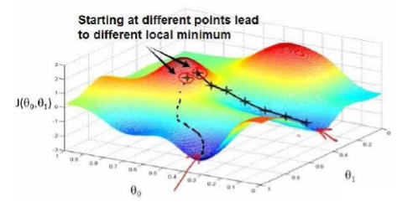
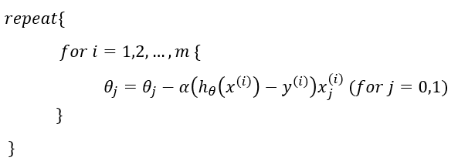

梯度下降
梯度下降的本质：一种使用梯度去迭代更新权重参数使目标函数最小化的方法。
梯度下降的基本步骤：
1.初始化（$θ1, θ2, …, θ_{n}$），计算代价函数；
2. 求解梯度，寻找下一个能让代价函数值下降最多的参数组合，更新（$θ1, θ2, …, θ_{n}$）
3. 迭代第2步直到稳定，此时得到一个局部最小值。
4. 选择不同的初始参数组合，重迭代2、3步。
Notes:
W,b

Slide 13


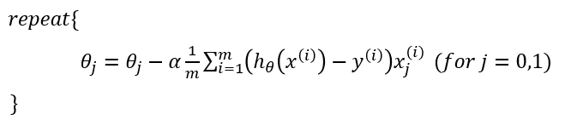

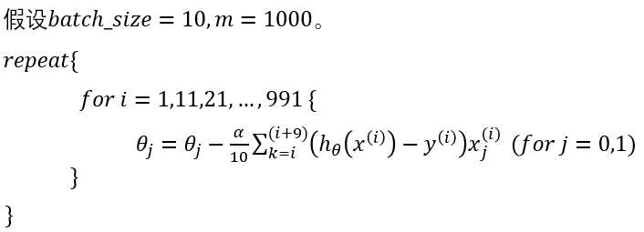
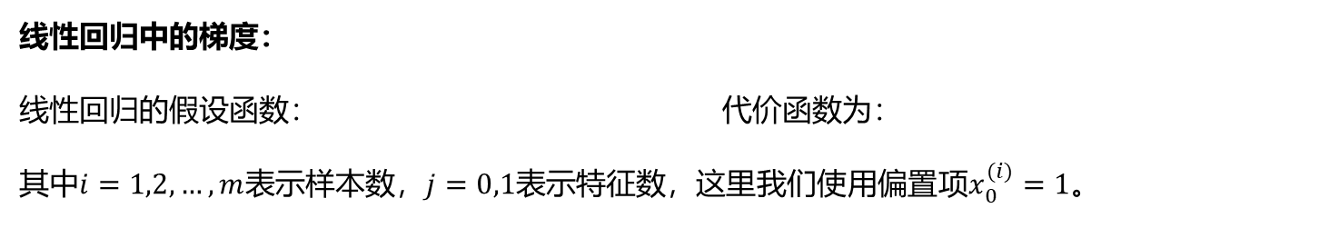
梯度下降
线性回归中的梯度：
线性回归的假设函数： 代价函数为：
其中$i=1,2,…,m$表示样本数，$j=0,1$表示特征数，这里我们使用偏置项$x_{0}^{(i)}=1$。
批量梯度下降(BGD) ：最原始的形式，在每一次迭代时使用所有样本来对参数进行更新。
随机梯度下降(SGD) ：在每一次迭代时使用一个样本来对参数进行更新。
小批量梯度下降(MBGD) ：在每一次迭代时使用batch_size个样本来对参数进行更新。

Slide 14
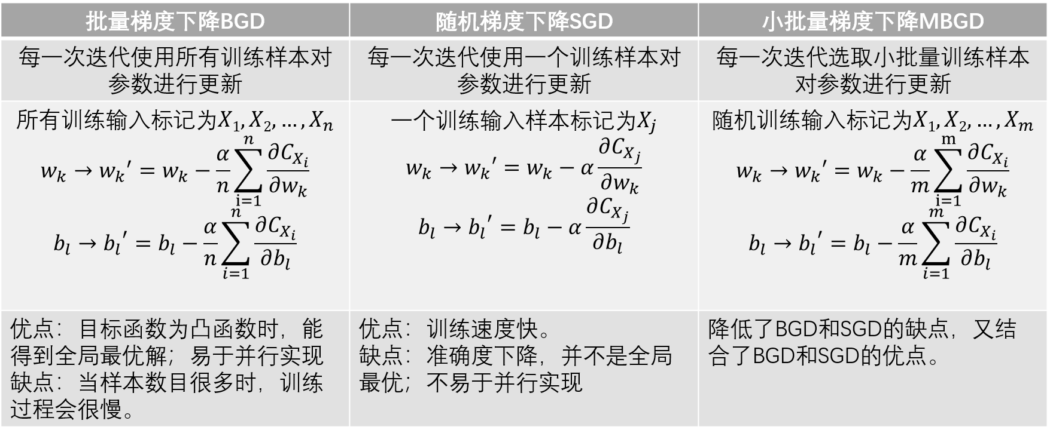
梯度下降
Notes:
W,b

Slide 15
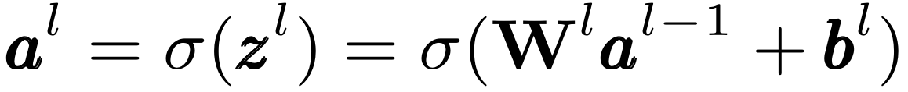
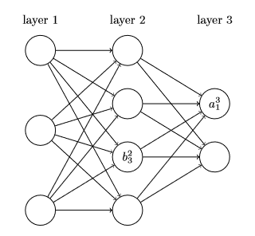
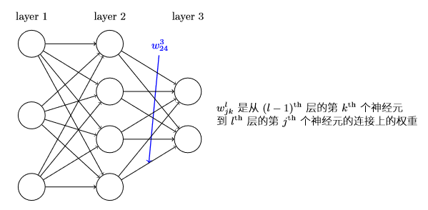


正向传播
明确网络中权重$W_{jk}^{l}、$偏置$b_{j}^{l}和$激活值$a_{j}^{l}$的清晰定义
$W_{jk}^{l}$表示从${(l−1)}^{th}$层的$k^{th}个$神经元到$l^{th}$层的$j^{th}个$神经元的链接上的权重。
$b_{j}^{l}表示l^{th}层$第$j^{th}$个神经元的偏置。
$a_{j}^{l}表示l^{th}层$第$j^{th}$个神经元的激活值。

Slide 16
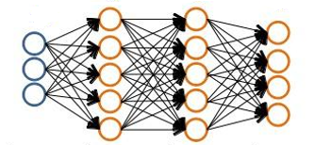
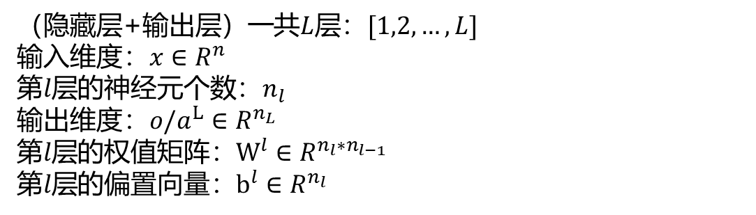
正向传播
（隐藏层+输出层）一共$L$层：$[1,2,…,L]$
输入维度：$x∈R^{n}$
第$l层$的神经元个数：$n_{l}$
输出维度：$o/a^{L}∈R^{n_{L}}$
第$l层$的权值矩阵：$W^{l}∈R^{n_{l}∗n_{l−1}}$
第$l层$的偏置向量：$b^{l}∈R^{n_{l}}$

Slide 17
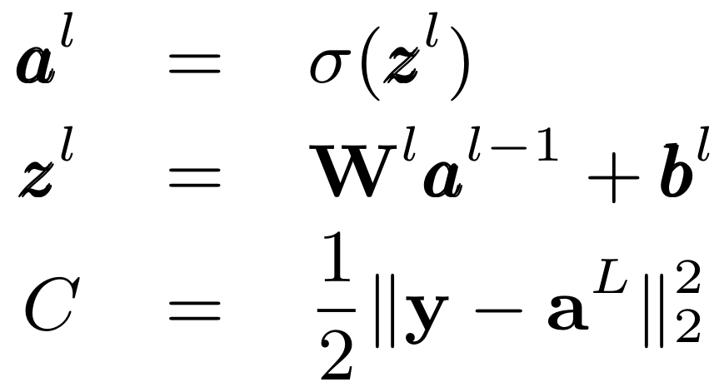
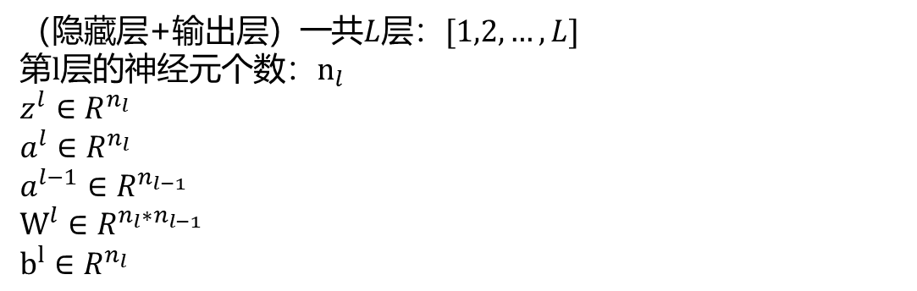
正向传播
正向传播的核心方程：
（隐藏层+输出层）一共$L$层：$[1,2,…,L]$
第$l层$的神经元个数：$n_{l}$
$$z^{l}∈R^{n_{l}}$$
$$a^{l}∈R^{n_{l}}$$
$$a^{l−1}∈R^{n_{l−1}}$$
$$W^{l}∈R^{n_{l}∗n_{l−1}}$$
$$b^{l}∈R^{n_{l}}$$
Notes:
写到黑板上

Slide 18
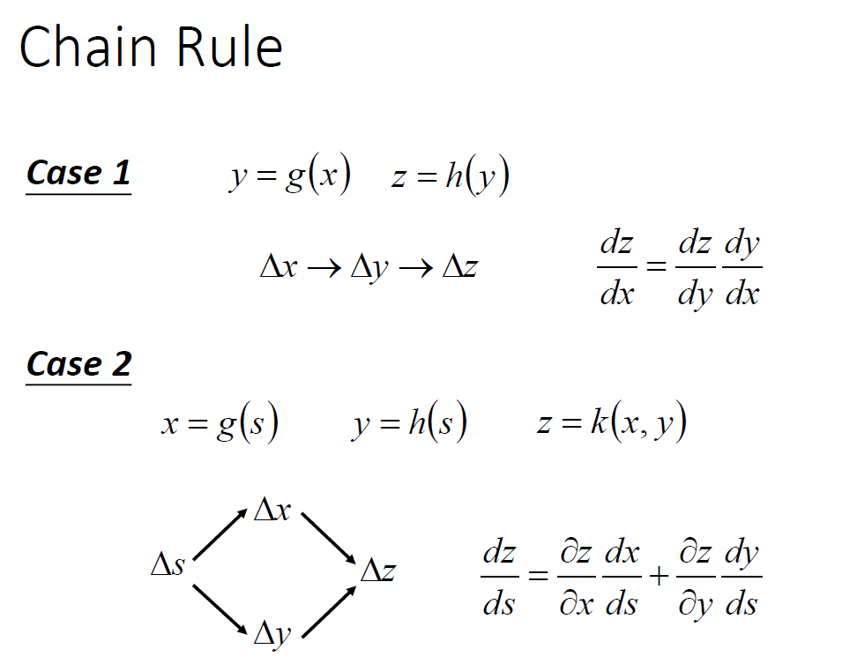
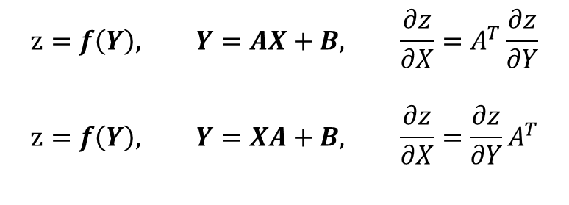
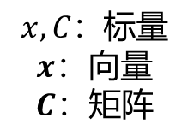
反向传播
$$x,C：标量$$
$$x：向量$$
$$C：矩阵$$
$$z=f\left(Y\right), Y=AX+B, \frac{∂z}{∂X}=A^{T}\frac{∂z}{∂Y}$$
$$z=f\left(Y\right), Y=XA+B, \frac{∂z}{∂X}=\frac{∂z}{∂Y}A^{T}$$

Slide 19
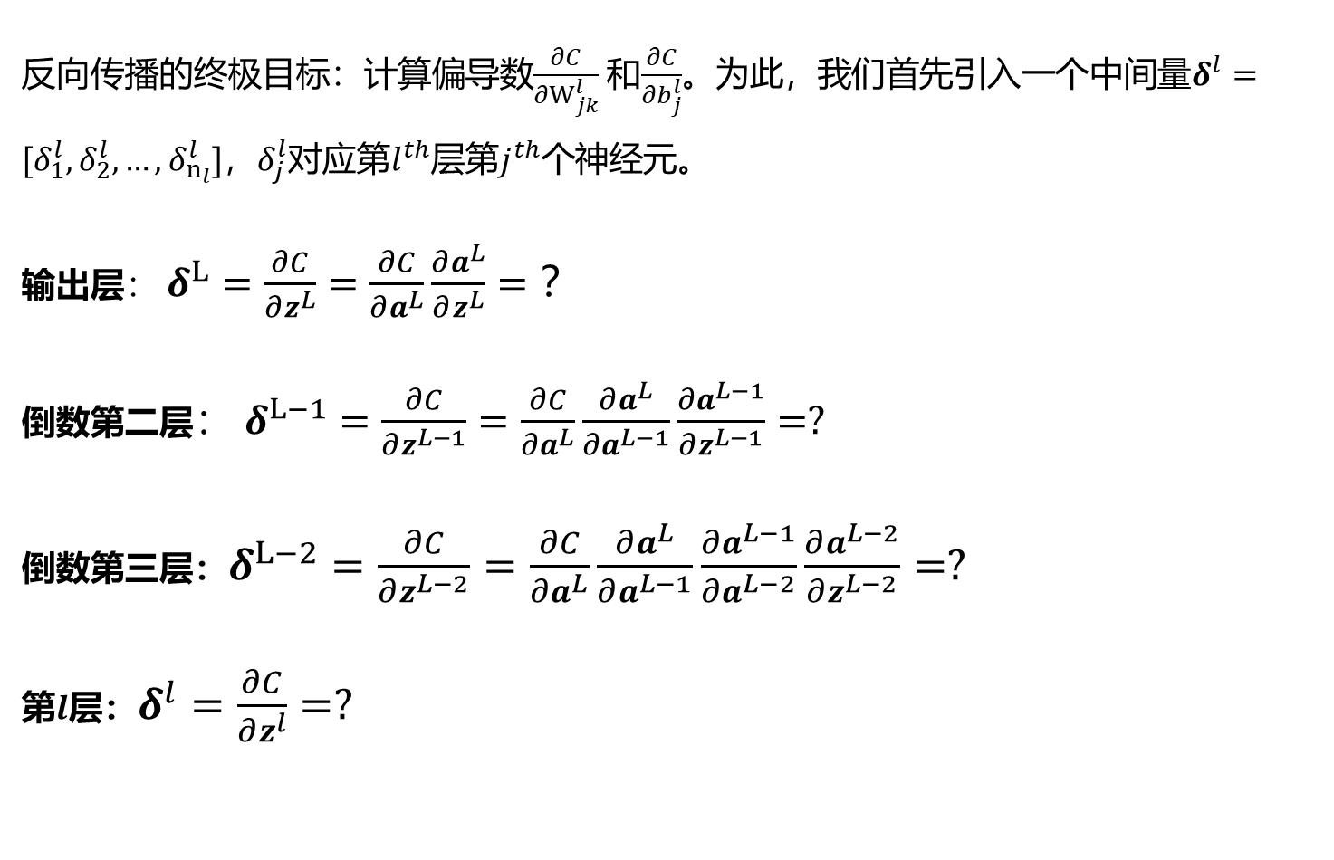
反向传播
反向传播的终极目标：计算偏导数$\frac{∂C}{∂W_{jk}^{l}}$和$\frac{∂C}{∂b_{j}^{l}}$。为此，我们首先引入一个中间量$δ^{l}=[δ_{1}^{l},δ_{2}^{l},…,δ_{n_{l}}^{l}]$，$δ_{j}^{l}$对应第$l^{th}$层第$j^{th}$个神经元。
输出层： $δ^{L}=\frac{∂C}{∂z^{L}}=\frac{∂C}{∂a^{L}}\frac{∂a^{L}}{∂z^{L}}=？$
倒数第二层： $δ^{L−1}=\frac{∂C}{∂z^{L−1}}=\frac{∂C}{∂a^{L}}\frac{∂a^{L}}{∂a^{L−1}}\frac{∂a^{L−1}}{∂z^{L−1}}=?$
倒数第三层：$δ^{L−2}=\frac{∂C}{∂z^{L−2}}=\frac{∂C}{∂a^{L}}\frac{∂a^{L}}{∂a^{L−1}}\frac{∂a^{L−1}}{∂a^{L−2}}\frac{∂a^{L−2}}{∂z^{L−2}}=?$
第$l$层：$δ^{l}=\frac{∂C}{∂z^{l}}=?$

Slide 20
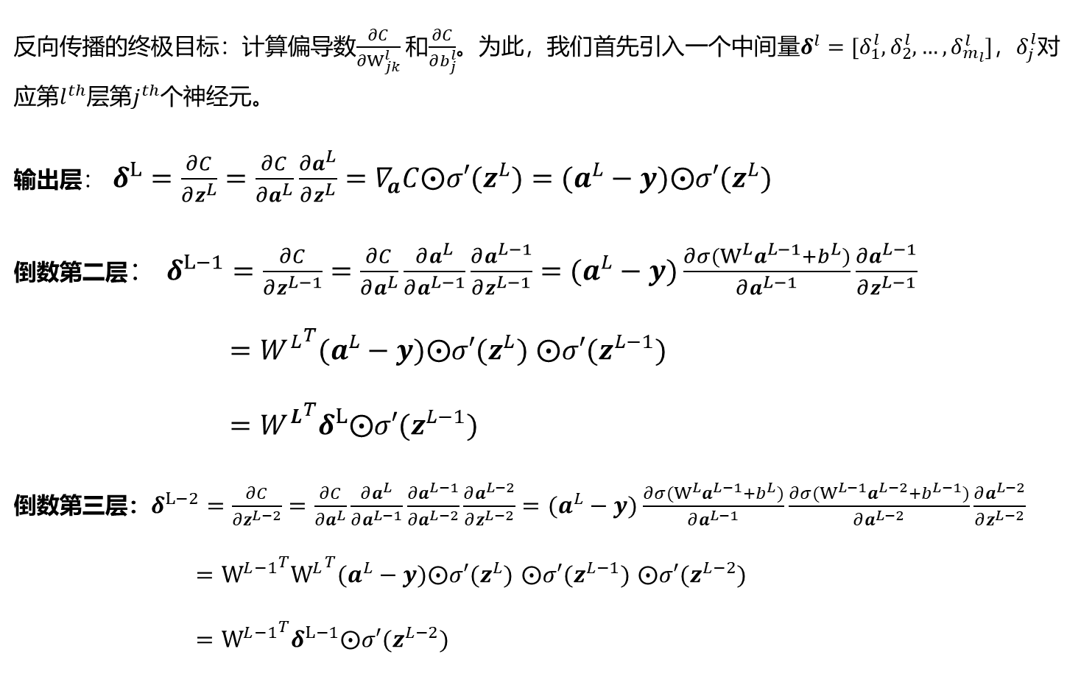
反向传播
反向传播的终极目标：计算偏导数$\frac{∂C}{∂W_{jk}^{l}}$和$\frac{∂C}{∂b_{j}^{l}}$。为此，我们首先引入一个中间量$δ^{l}=[δ_{1}^{l},δ_{2}^{l},…,δ_{m_{l}}^{l}]$，$δ_{j}^{l}$对应第$l^{th}$层第$j^{th}$个神经元。
输出层： $δ^{L}=\frac{∂C}{∂z^{L}}=\frac{∂C}{∂a^{L}}\frac{∂a^{L}}{∂z^{L}}=∇_{a}C⨀σ′(z^{L})=(a^{L}−y)⨀σ′(z^{L})$
倒数第二层： $δ^{L−1}=\frac{∂C}{∂z^{L−1}}=\frac{∂C}{∂a^{L}}\frac{∂a^{L}}{∂a^{L−1}}\frac{∂a^{L−1}}{∂z^{L−1}}=(a^{L}−y)\frac{∂{σ(W^{L}a}^{L−1}+b^{L})}{∂a^{L−1}}\frac{∂a^{L−1}}{∂z^{L−1}}$
$={W^{L}}^{T}(a^{L}−y)⨀σ′(z^{L})$ $⨀σ′(z^{L−1})$
$={W^{L}}^{T}δ^{L}⨀σ′(z^{L−1})$
倒数第三层：$δ^{L−2}=\frac{∂C}{∂z^{L−2}}=\frac{∂C}{∂a^{L}}\frac{∂a^{L}}{∂a^{L−1}}\frac{∂a^{L−1}}{∂a^{L−2}}\frac{∂a^{L−2}}{∂z^{L−2}}=(a^{L}−y)\frac{∂{σ(W^{L}a}^{L−1}+b^{L})}{∂a^{L−1}}\frac{∂{σ(W^{L−1}a}^{L−2}+b^{L−1})}{∂a^{L−2}}\frac{∂a^{L−2}}{∂z^{L−2}}$
$={W^{L−1}}^{T}{W^{L}}^{T}(a^{L}−y)⨀σ′(z^{L})$ $⨀σ′(z^{L−1})$ $⨀σ′(z^{L−2})$
$={W^{L−1}}^{T}δ^{L−1}⨀σ′(z^{L−2})$

Slide 21

反向传播
反向传播的4个核心方程：
输出层：$δ^{L}=\frac{∂C}{∂z^{L}}=\frac{∂C}{∂a^{L}}\frac{∂a^{L}}{∂z^{L}}=∇_{a}C⨀σ′(z^{L})$
第$l$层： $δ^{l}=\frac{∂C}{∂z^{l}}={W^{l+1}}^{T}δ^{l+1}⨀σ′(z^{l})$
$\frac{∂C}{∂W^{l}}=\frac{∂C}{∂z^{l}}\frac{∂z^{l}}{∂W^{l}}=δ^{l}{\left(a^{l−1}\right)}^{T}$
$\frac{∂C}{∂b^{l}}=\frac{∂C}{∂z^{l}}\frac{∂z^{l}}{∂b^{l}}=δ^{l}$

Slide 22
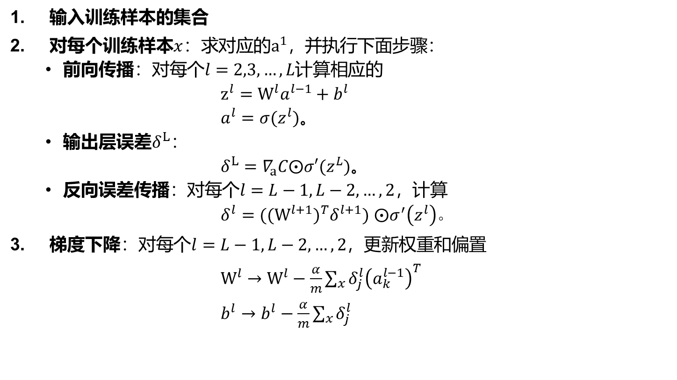
神经网络训练
输入训练样本的集合
对每个训练样本$x$：求对应的$a^{1}，$并执行下面步骤：
前向传播：对每个$l=2,3,…,L计算$相应的
$z^{l}=W^{l}a^{l−1}+b^{l}$
$a^{l}=σ(z^{l})$。
输出层误差$δ^{L}$：
$δ^{L}=∇_{a}C⨀σ′(z^{L})$。
反向误差传播：对每个$l=L−1,L−2,…,2$，计算
$δ^{l}=({(W^{l+1})}^{T}δ^{l+1})$ $⨀σ^{′}\left(z^{l}\right)$。
梯度下降：对每个$l=L−1,L−2,…,2$，更新权重和偏置
$W^{l}→W^{l}−\frac{α}{m}\sum_{x}{δ_{j}^{l}{\left(a_{k}^{l−1}\right)}^{T}}$
$b^{l}→b^{l}−\frac{α}{m}\sum_{x}{δ_{j}^{l}}$

Slide 23
反向传播带来的问题
梯度爆炸：就是由于初始化权值过大，前面层会比后面层变化的更快，就会导致权值越来越大，梯度爆炸的现象就发生了。
梯度弥散：由于sigmod函数在趋于无限大时，梯度会逐渐消失，随着传播深度的增加（如7层以上），残差传播到底层时已经变得太小，梯度的幅度也会急剧减小，导致浅层神经元的权重更新非常缓慢，无法有效进行学习。
（反向传播基于的是链式求导法则。如果导数小于1，那么随着层数的增多，梯度的更新量会以指数形式衰减，结果就是越靠近输出层的网络层参数更新比较正常，而靠近输入层的网络层参数可能基本就不更新。这就是梯度消失。而如果导数值大于1，那么由于链式法则的连乘，梯度更新量是会成指数级增长的。这就是梯度爆炸。）

Slide 24
欠拟合与过拟合：
欠拟合：
--模型对数据的表征能力不足
--易于解决，提高模型拟合能力（选择更强大的模型、进行特征工程、减少模型的约束）
过拟合：
--模型与训练数据拟合程度过高，通常是由于学习了与特征无关的噪声导致的
--解决过拟合，提高模型泛化能力、鲁棒性（修改模型设计、参数正则化、Dropout、Batch Normalization等）

Slide 25
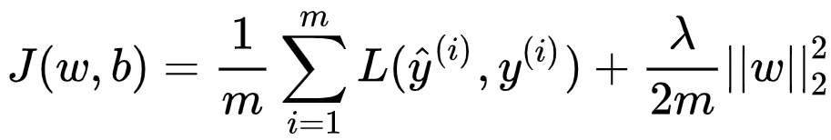
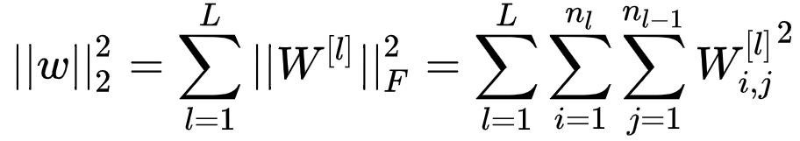
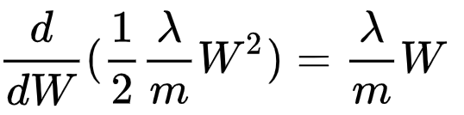

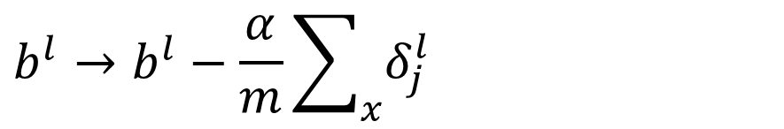
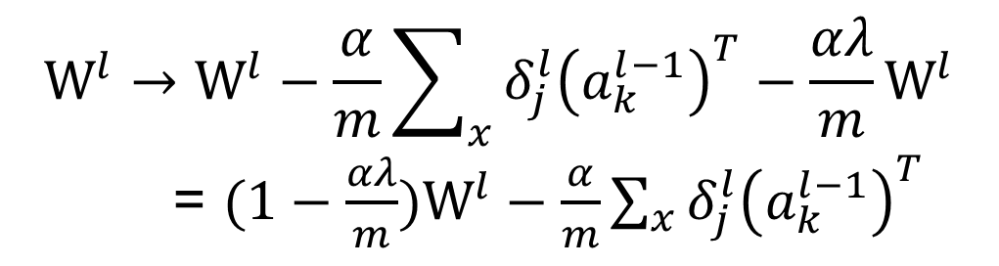

过拟合与正则化：
$$W^{l}→W^{l}−\frac{α}{m}\sum_{x}{δ_{j}^{l}{\left(a_{k}^{l−1}\right)}^{T}}−\frac{αλ}{m}W^{l}$$
= $(1−\frac{αλ}{m})W^{l}−\frac{α}{m}\sum_{x}{δ_{j}^{l}{\left(a_{k}^{l−1}\right)}^{T}}$
$α为$步长
$W^{l}衰减1−\frac{αλ}{m}$倍
$$b^{l}→b^{l}−\frac{α}{m}\sum_{x}{δ_{j}^{l}}$$

Slide 26






过拟合与正则化：
$$W^{l}→W^{l}−\frac{α}{m}\sum_{x}{δ_{j}^{l}{\left(a_{k}^{l−1}\right)}^{T}}−\frac{αλ}{m}{sgn⁡(W}^{l})$$
$$b^{l}→b^{l}−\frac{α}{m}\sum_{x}{δ_{j}^{l}}$$
L1-norm v.s. l2-norm ?

Slide 27
关键因素：
影响神经网络性能的关键因素：
模型架构很重要
数据很重要
优化方法很重要

Slide 28

关键参数与调参原则：
参数 (Parameter)：$W^{l}$， $b^{l}$
超参 (Hyperparameter)：步长learning rate:$α$
外循环迭代次数loop
内循环迭代次数interations
网络层数: L
每层神经元个数:$n^{1},n^{2},…,n^{L}$
激活函数
代价函数，等
Bayes error (Human) 1%
Training error 5%
Validation error 12%
可以通过使用更大的网络、训练更长时间、改变优化算法（SGD->Adam）、修改网络结构、修改超参等方式解决avoidable bias。
通过正则化、使用更大训练集合、修改网络结构、修改超参等方式解决variance问题。
4%的差异, 源于bias
7%的差异，源于variance

Slide 29


深度学习平台：

Slide 30

监督学习框架与算法实现
训练过程 Training
验证过程 Validation
拟合函数（模型） h
拟合函数（模型） h
代价函数C
正向传播
正向传播
代价函数
反向传播
测试过程 Test
拟合函数（模型） h
模型参数更新
正向传播

Slide 31
样例1： NN-numpy
import numpy as np
import math
# Create random input and output data
x = np.linspace(-math.pi, math.pi, 2000)
y = np.sin(x)
# Randomly initialize weights
a = np.random.randn()
b = np.random.randn()
c = np.random.randn()
d = np.random.randn()
learning_rate = 1e-6

Slide 32
样例1： NN-numpy
for t in range(2000):
# Forward pass: compute predicted y
y_pred = a + b * x + c * x ** 2 + d * x ** 3
# Compute and print loss
# Backprop to compute gradients of a, b, c, d with respect to loss
# Update weights

Slide 33
样例1： NN-numpy
for t in range(2000):
# Forward pass: compute predicted y
y_pred = a + b * x + c * x ** 2 + d * x ** 3
# Compute and print loss
loss = np.square(y_pred - y).sum()
if t % 100 == 99:
print(t, loss)
# Backprop to compute gradients of a, b, c, d with respect to loss
grad_y_pred = 2.0 * (y_pred - y)
grad_a = grad_y_pred.sum()
grad_b = (grad_y_pred * x).sum()
grad_c = (grad_y_pred * x ** 2).sum()
grad_d = (grad_y_pred * x ** 3).sum()
# Update weights
a -= learning_rate * grad_a
b -= learning_rate * grad_b
c -= learning_rate * grad_c
d -= learning_rate * grad_d

Slide 34
样例2：NN-tensor
import torch
import math
dtype = torch.float
device = torch.device("cpu")
# device = torch.device("cuda:0") # Uncomment this to run on GPU
# Create random input and output data
x = torch.linspace(-math.pi, math.pi, 2000, device=device, dtype=dtype)
y = torch.sin(x)
# Randomly initialize weights
a = torch.randn((), device=device, dtype=dtype)
b = torch.randn((), device=device, dtype=dtype)
c = torch.randn((), device=device, dtype=dtype)
d = torch.randn((), device=device, dtype=dtype)
learning_rate = 1e-6

Slide 35
样例2： NN-tensor
for t in range(2000):
# Forward pass: compute predicted y
y_pred = a + b * x + c * x ** 2 + d * x ** 3
# Compute and print loss
loss = (y_pred - y).pow(2).sum().item()
if t % 100 == 99:
print(t, loss)
# Backprop to compute gradients of a, b, c, d with respect to loss
grad_y_pred = 2.0 * (y_pred - y)
grad_a = grad_y_pred.sum()
grad_b = (grad_y_pred * x).sum()
grad_c = (grad_y_pred * x ** 2).sum()
grad_d = (grad_y_pred * x ** 3).sum()
# Update weights using gradient descent
a -= learning_rate * grad_a
b -= learning_rate * grad_b
c -= learning_rate * grad_c
d -= learning_rate * grad_d

Slide 36
样例3： NN-autograd
import torch
import math
dtype = torch.float
device = torch.device("cpu")
# device = torch.device("cuda:0") # Uncomment this to run on GPU
# Create Tensors to hold input and outputs. By default, requires_grad=False
x = torch.linspace(-math.pi, math.pi, 2000, device=device, dtype=dtype)
y = torch.sin(x)
# Create random Tensors for weights. For a third order polynomial, we need
# 4 weights: y = a + b x + c x^2 + d x^3
# Setting requires_grad=True indicates that we want to compute gradients with
# respect to these Tensors during the backward pass.
a = torch.randn((), device=device, dtype=dtype, requires_grad=True)
b = torch.randn((), device=device, dtype=dtype, requires_grad=True)
c = torch.randn((), device=device, dtype=dtype, requires_grad=True)
d = torch.randn((), device=device, dtype=dtype, requires_grad=True)
Notes:
# By default, requires_grad=False, which indicates that we do not need to
# compute gradients with respect to these Tensors during the backward pass.

Slide 37
样例3：NN-autograd
for t in range(2000):
# Forward pass: compute predicted y using operations on Tensors.
y_pred = a + b * x + c * x ** 2 + d * x ** 3
# Compute and print loss using operations on Tensors.
# loss.item() gets the scalar value held in the loss.
loss = (y_pred - y).pow(2).sum()
if t % 100 == 99: print(t, loss.item())
# Use autograd to compute the backward pass.
loss.backward()
# Manually update weights using gradient descent.
with torch.no_grad():
a -= learning_rate * a.grad
b -= learning_rate * b.grad
c -= learning_rate * c.grad
d -= learning_rate * d.grad
# Manually zero the gradients after updating weights
a.grad = None; b.grad = None; c.grad = None; d.grad = None;

Slide 38
样例4：NN-autograd+通用化表示
import torch
import math
# Create Tensors to hold input and outputs.
x = torch.linspace(-math.pi, math.pi, 2000)
y = torch.sin(x)
# For this example, the output y is a linear function of (x, x^2, x^3)
# x: (2000)—— x.unsqueeze(-1) :(2000, 1), p:(3) —— xx: (2000, 3)
p = torch.tensor([1, 2, 3])
xx = x.unsqueeze(-1).pow(p)
# Use the nn package to define our model as a sequence of layers. nn.Sequential
# is a Module which contains other Modules
model = torch.nn.Sequential(
torch.nn.Linear(3, 1),
torch.nn.Flatten(0, 1))
# The nn package also contains definitions of popular loss functions
loss_fn = torch.nn.MSELoss(reduction='sum')
learning_rate = 1e-6
Notes:
# By default, requires_grad=False, which indicates that we do not need to
# compute gradients with respect to these Tensors during the backward pass.

Slide 39
样例4： NN-autograd+通用化表示
for t in range(2000):
# Forward pass: compute predicted y by passing x to the model.
y_pred = model(xx)
# Compute and print loss.
loss = loss_fn(y_pred, y)
if t % 100 == 99: print(t, loss.item())
# Zero the gradients before running the backward pass.
model.zero_grad()
# Backward pass:
loss.backward()
# Update the weights using gradient descent.
with torch.no_grad():
for param in model.parameters():
param -= learning_rate * param.grad
# You can access the first layer of `model` like accessing the first item of a list
linear_layer = model[0]

Slide 40
样例5：NN-optimizer+通用化表示
import torch
import math
# Create Tensors to hold input and outputs.
x = torch.linspace(-math.pi, math.pi, 2000)
y = torch.sin(x)
# Prepare the input tensor (x, x^2, x^3).
p = torch.tensor([1, 2, 3])
xx = x.unsqueeze(-1).pow(p)
# Use the nn package to define our model and loss function.
model = torch.nn.Sequential(
torch.nn.Linear(3, 1),
torch.nn.Flatten(0, 1))
loss_fn = torch.nn.MSELoss(reduction='sum')
learning_rate = 1e-6
Notes:
# By default, requires_grad=False, which indicates that we do not need to
# compute gradients with respect to these Tensors during the backward pass.

Slide 41
样例5： NN-optimizer+通用化表示
# Use the optim package to define an Optimizer that will update the weights of
# the model for us.
optimizer = torch.optim.SGD(model.parameters(), lr=learning_rate)
for t in range(2000):
# Forward pass: compute predicted y by passing x to the model.
y_pred = model(xx)
# Compute and print loss.
loss = loss_fn(y_pred, y)
if t % 100 == 99: print(t, loss.item())
# Before the backward pass
optimizer.zero_grad()
# Backward pass: compute gradient of the loss with respect to model parameters
loss.backward()
# Calling the step function on an Optimizer makes an update to its parameters
optimizer.step()
Notes:
use the optimizer object to zero all of the gradients for the variables it will update

Slide 42

样例6：NN-时装分类
Notes:
# By default, requires_grad=False, which indicates that we do not need to
# compute gradients with respect to these Tensors during the backward pass.

Slide 43
样例6：NN-时装分类
import torch
from torch import nn
from torch.utils.data import DataLoader
from torchvision import datasets
from torchvision.transforms import ToTensor, Lambda, Compose
import matplotlib.pyplot as plt
# Download training data from open datasets.
training_data = datasets.FashionMNIST(
root="data",
train=True,
download=True,
transform=ToTensor(),
)
# Download test data from open datasets.
test_data = datasets.FashionMNIST(
root="data",
train=False,
download=True,
transform=ToTensor(),
)
Notes:
# By default, requires_grad=False, which indicates that we do not need to
# compute gradients with respect to these Tensors during the backward pass.

Slide 44
样例6： NN-时装分类
batch_size = 64
# Create data loaders.
train_dataloader = DataLoader(training_data, batch_size=batch_size)
test_dataloader = DataLoader(test_data, batch_size=batch_size)
for X, y in test_dataloader:
print("Shape of X [N, C, H, W]: ", X.shape)
print("Shape of y: ", y.shape, y.dtype)
break
# Get cpu or gpu device for training.
device = "cuda" if torch.cuda.is_available() else "cpu"
print("Using {} device".format(device))
Notes:
use the optimizer object to zero all of the gradients for the variables it will update

Slide 45
样例6： NN-时装分类
# Define model
class NeuralNetwork(nn.Module):
def __init__(self):
super(NeuralNetwork, self).__init__()
self.flatten = nn.Flatten()
self.linear_relu_stack = nn.Sequential(
nn.Linear(28*28, 512),
nn.ReLU(),
nn.Linear(512, 512),
nn.ReLU(),
nn.Linear(512, 10),
nn.ReLU()
)
def forward(self, x):
x = self.flatten(x)
logits = self.linear_relu_stack(x)
return logits
model = NeuralNetwork().to(device)
print(model)

Slide 46
样例6： NN-时装分类
loss_fn = nn.CrossEntropyLoss()
optimizer = torch.optim.SGD(model.parameters(), lr=1e-3)
def train(dataloader, model, loss_fn, optimizer):
size = len(dataloader.dataset)
for batch, (X, y) in enumerate(dataloader):
X, y = X.to(device), y.to(device)
# Compute prediction error
pred = model(X)
loss = loss_fn(pred, y)
# Backpropagation
optimizer.zero_grad()
loss.backward()
optimizer.step()
if batch % 100 == 0:
loss, current = loss.item(), batch * len(X)
print(f"loss: {loss:>7f} [{current:>5d}/{size:>5d}]")

Slide 47
样例6： NN-时装分类
def test(dataloader, model):
size = len(dataloader.dataset)
model.eval()
test_loss, correct = 0, 0
with torch.no_grad():
for X, y in dataloader:
X, y = X.to(device), y.to(device)
pred = model(X)
test_loss += loss_fn(pred, y).item()
correct += (pred.argmax(1) == y).type(torch.float).sum().item()
test_loss /= size
correct /= size
print(f"Test Error: \n Accuracy: {(100*correct):>0.1f}%, Avg loss: {test_loss:>8f} \n")
epochs = 5
for t in range(epochs):
print(f"Epoch {t+1}\n-------------------------------")
train(train_dataloader, model, loss_fn, optimizer)
test(test_dataloader, model)
print("Done!")

